Slide 1
Data Analysis For Enhancing Web Design with Google Cloud Platform: A Powerful Tool for Creating Sound Objects.
Presented By
BIBEK LAMSAL

Slide 2
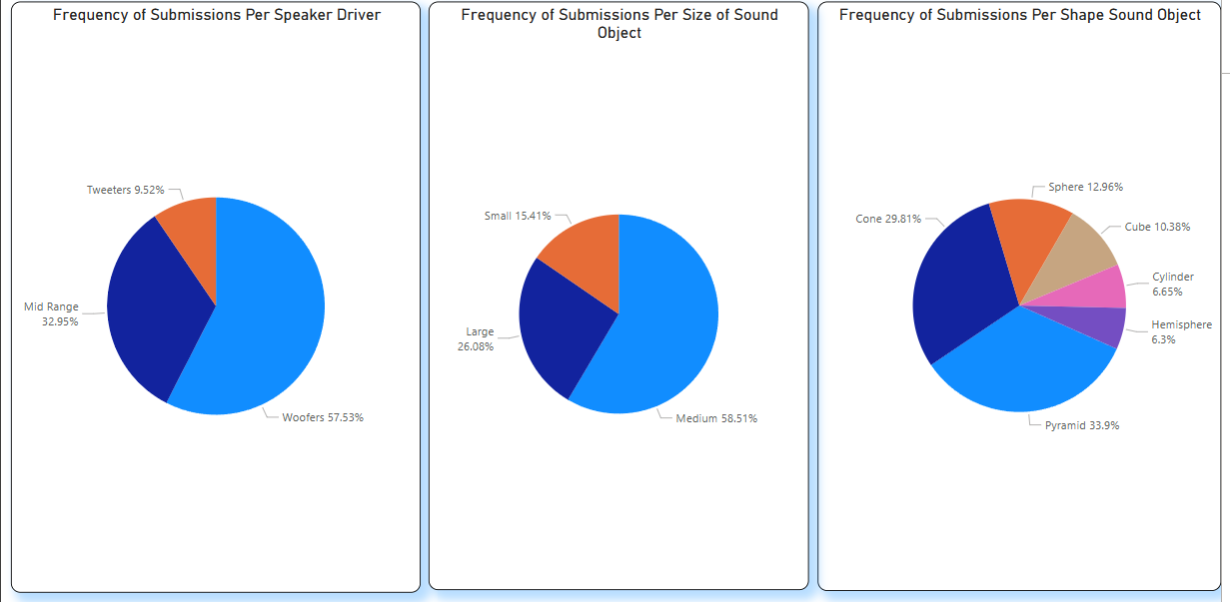
Visualization using dashboard

Slide 3
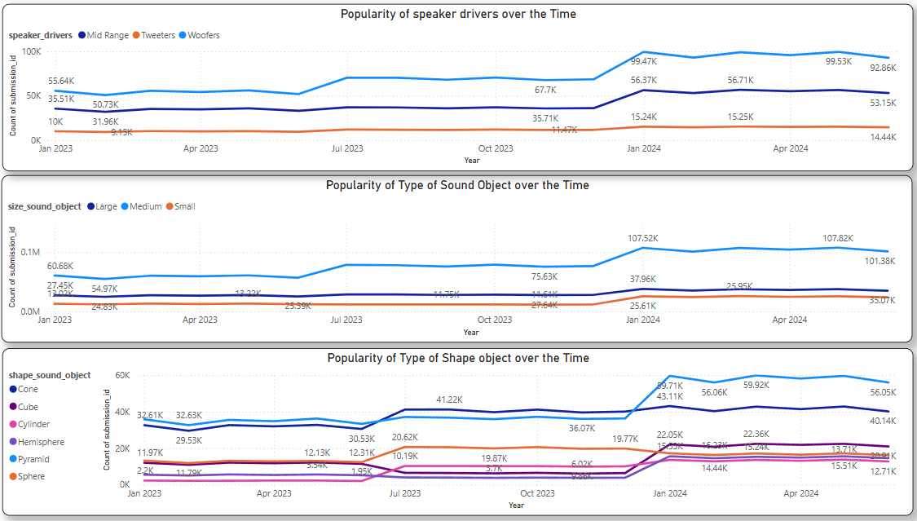

Slide 4
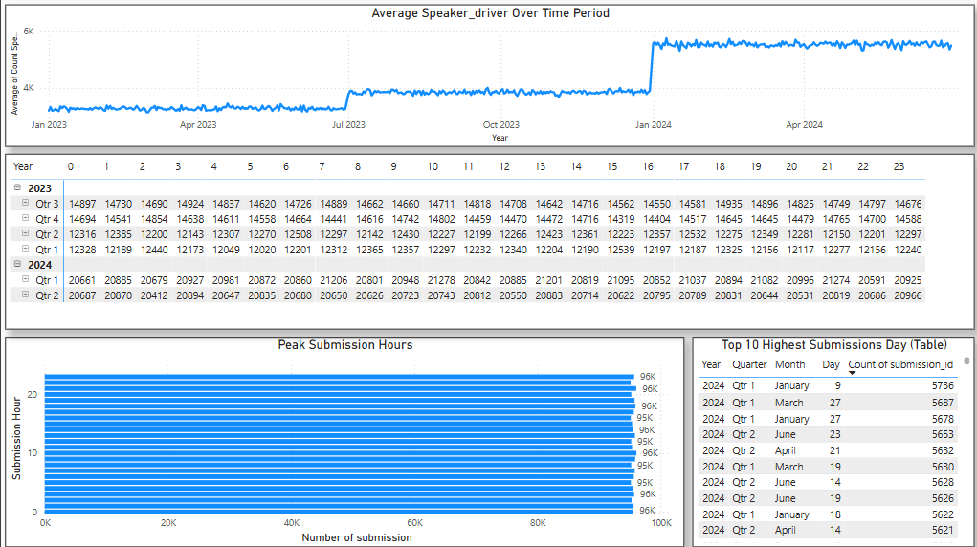

Slide 5
Insight:
Woofers Dominate the Speaker Driver Market: Woofers accounted for 57.53% of all submissions, with Mid-Range drivers at 32.95% and Tweeters at 9.52%.
Medium-Sized Sound Objects Are the Most Popular Choice: Over 58% of submissions were for medium-sized sound objects, making them the dominant choice among users.
Cone and Pyramid Shape Objects Are Preferred:: The most common shape submissions are Cone (29.81%) and Pyramid (33.9%), suggesting a strong user preference for these structures.
Peak Submission Hours: Submission activity appears evenly spread across all hours, indicating a 24/7 active submission pattern.
January 9, 2024, Had the Highest Submissions: The peak submission date recorded was January 9, 2024, with 5,736 submissions, followed by March 27 and January 27.

Slide 6
Recommandation
Capitalize on Peak Engagement in Early 2024 : Since Q1 2024 saw a major spike in submissions, targeted marketing campaigns and promotions should be focused during this period to maximize user engagement.
Optimize for 24/7 Activity: Given that submissions are evenly distributed throughout the day, implementing an automated moderation system or AI-driven assistance could help always manage high-volume submissions.
Expand Product Offerings Based on Popular Trends: Since medium-sized sound objects and Cone/Pyramid shapes are the most preferred, introducing new variations or features catering to these categories could drive more engagement and sales.

Slide 7
Call Through Action
Let’s set a meeting with the web designing team to brainstorm and test new approaches for developing diverse sound assets inspired by popular sound objects.

